Slide 1
Optimal Strategies for RoboFlag Game
Wei Zhang

Slide 2










One-Side RoboFlag Game
attacker
flag
Capture zone
Protected zone
defender

Slide 3



attacker
flag
Capture zone
Protected zone
defender

Slide 4

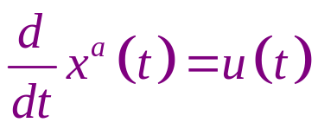
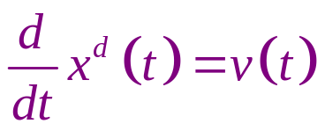
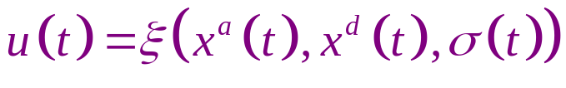
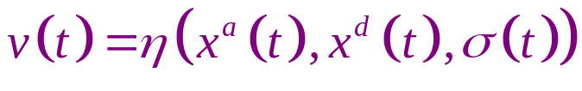
Problem Formulation
attacker
flag
Capture zone
Protected zone
defender

Slide 5


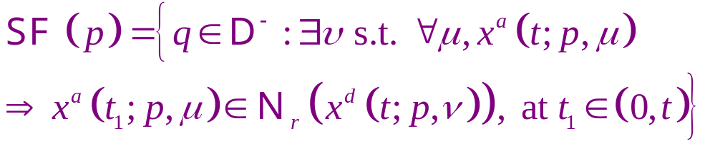
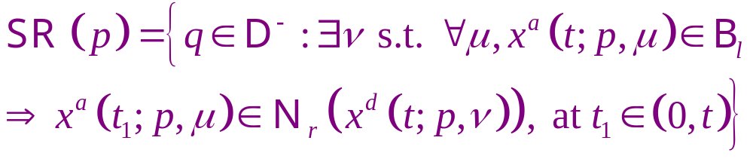

Solution Procedure
attacker
Stop flagging Set
flag
Capture zone
Stop return Set
Protected zone
defender
Minimum Flagging Time:

Slide 6


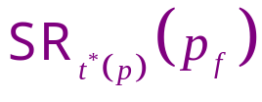

Key Lemma
Decomposition Lemma
Stop flagging Set
Winning Conf.
set
--Stop return Set

Slide 7

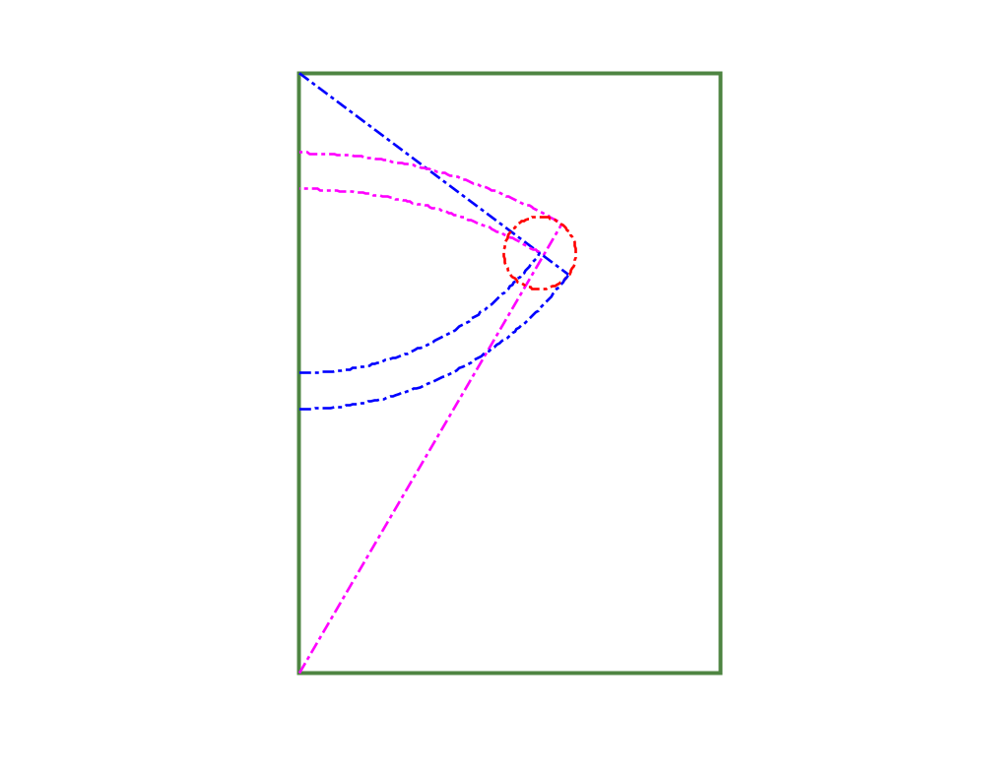
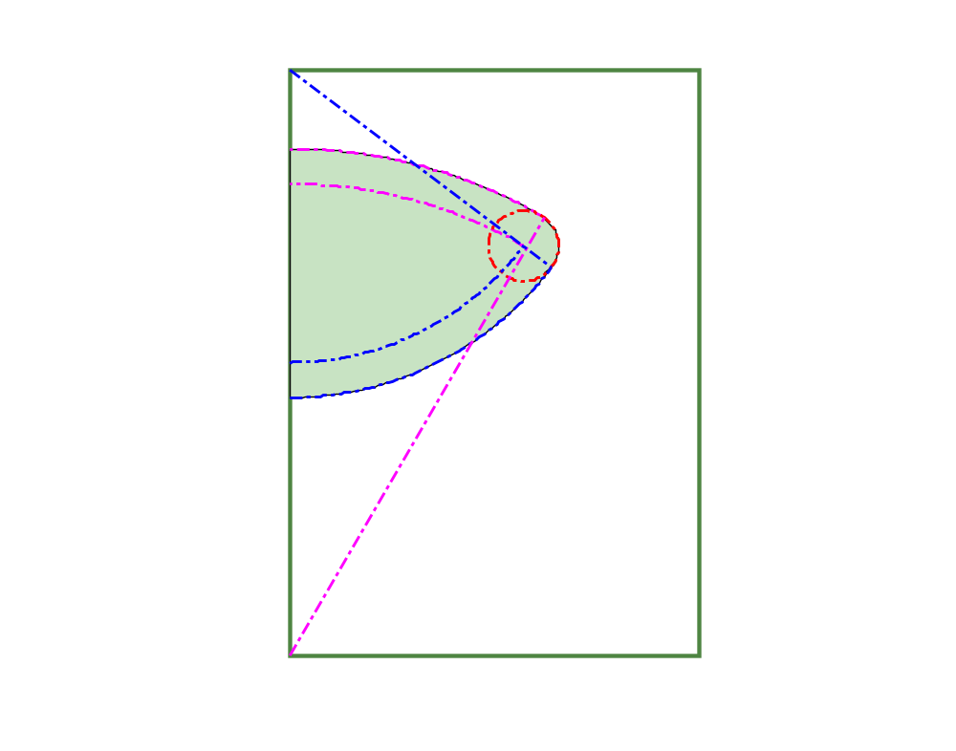





Stop Return Set

Slide 8

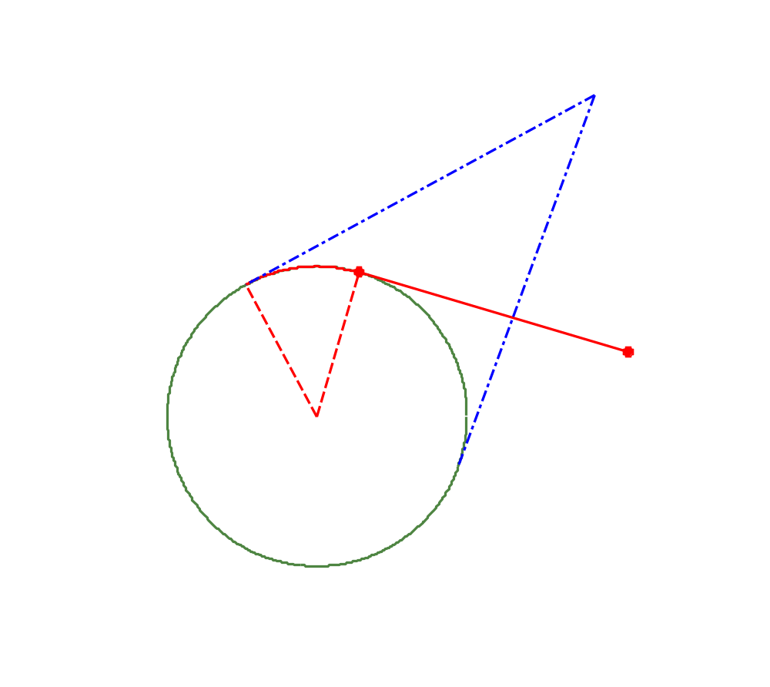
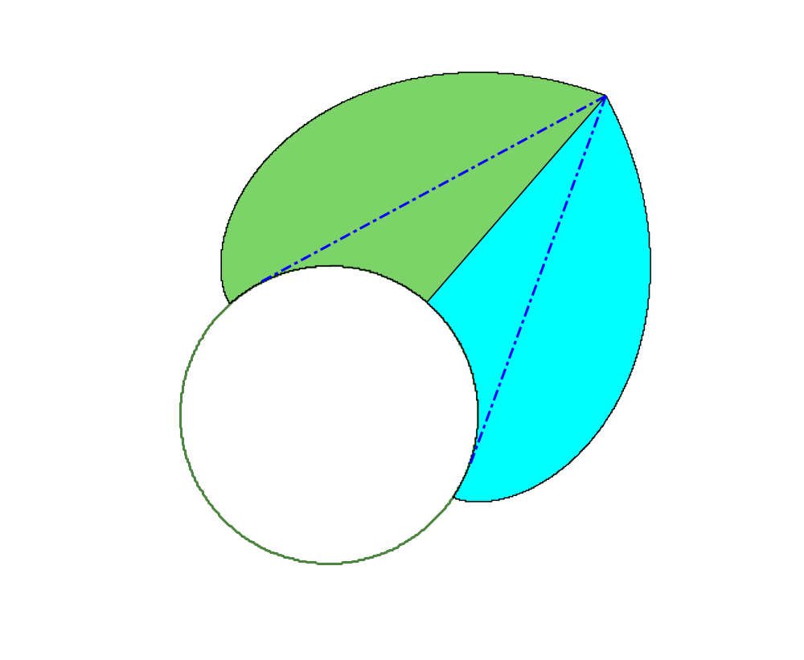



Stop Flag Set

Slide 9
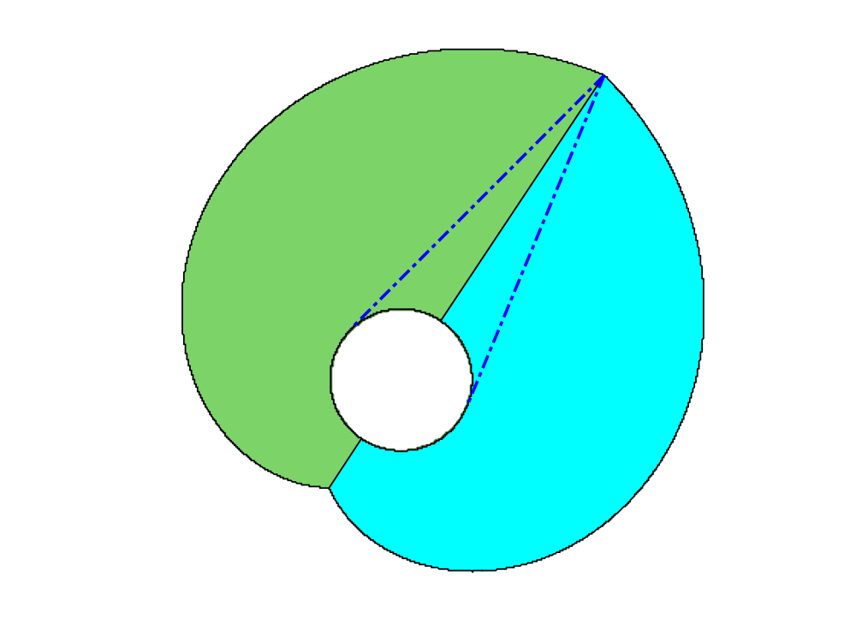
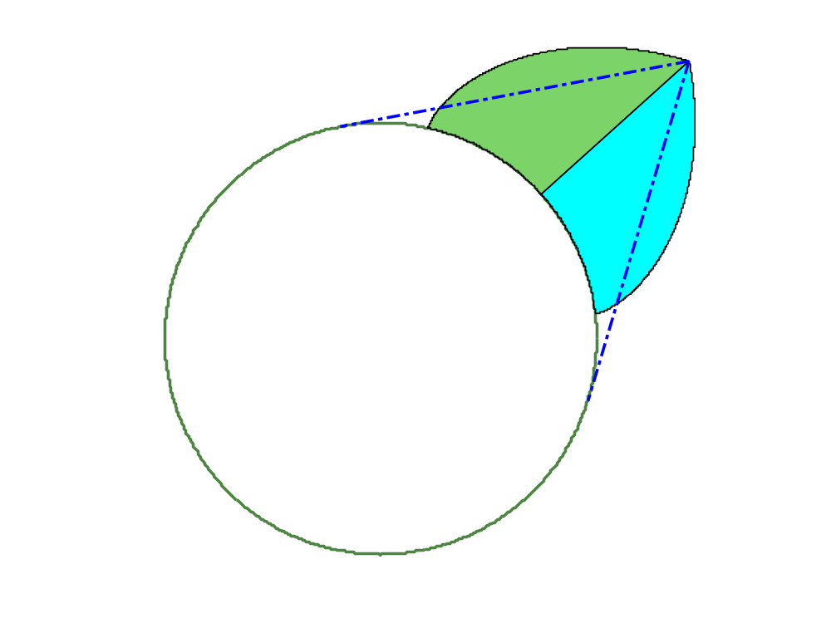

Slide 10
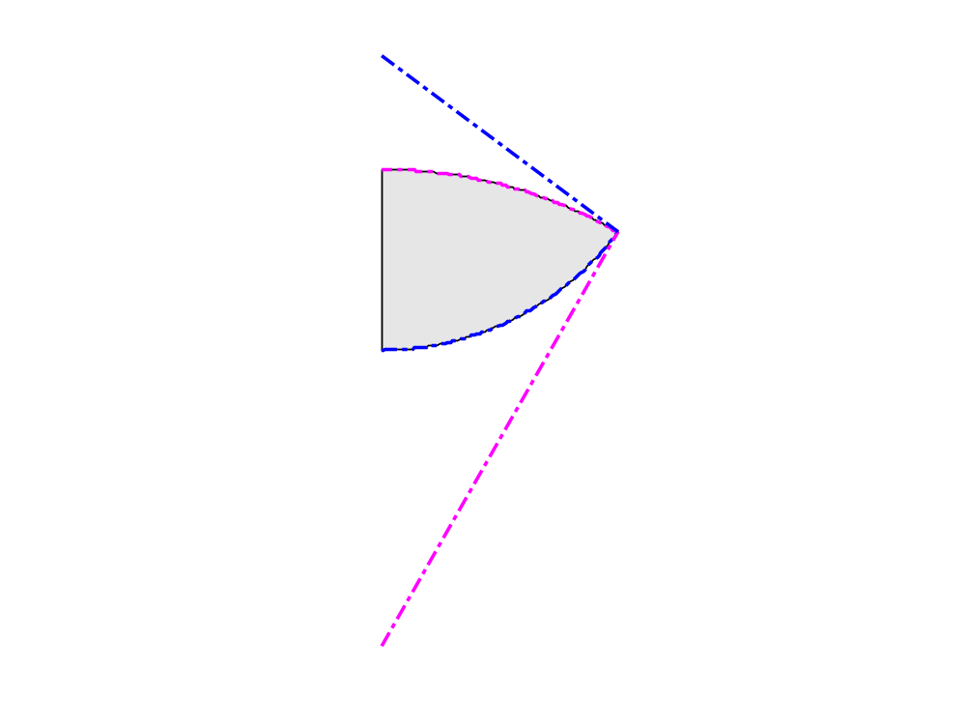












Return
region

Slide 11






Slide 12
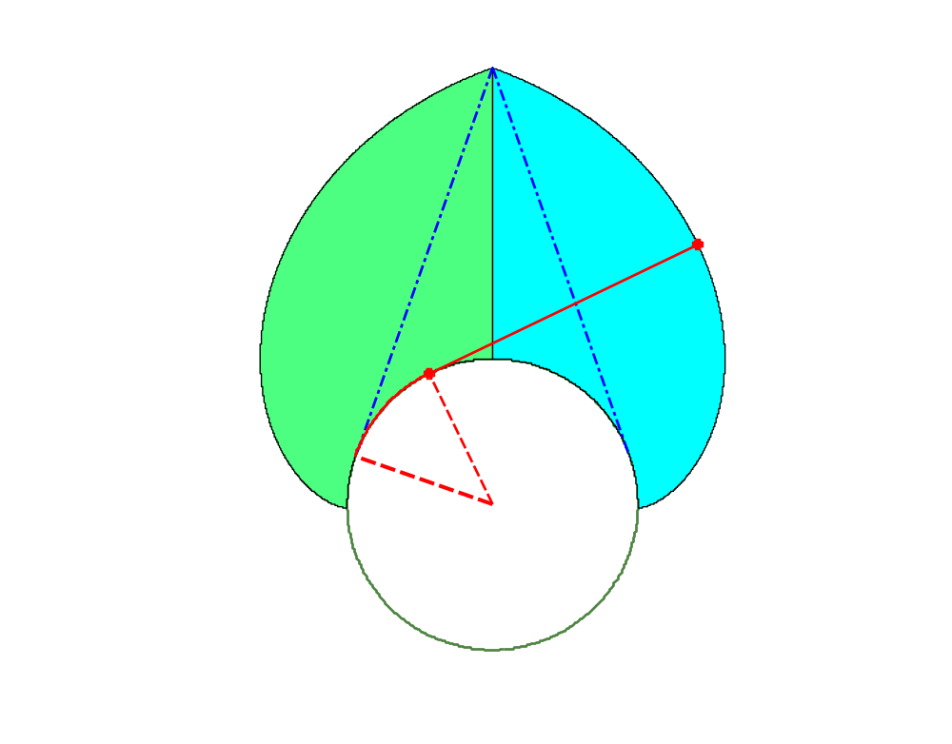












F

Slide 13
Thank you very much!

